Slide 1
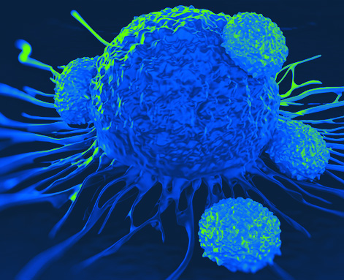
Lecture 3: The Cell and Cell Division

Slide 2
OVERVIEW
Structure vs. Function – how does anatomy control physiology?
Body Organization: The Cell – how does the cytoplasm function?
Body Organization: The Cell – what are organelles and how do they work?
Body Organization: The Cell – how do cells interact, age, and die?

Slide 3
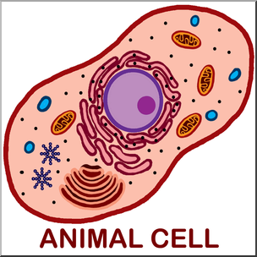
THE CELL
All living organisms are composed of cells.
Blood
cells
Ovum
Smooth
muscle cell
Bone
cell
Fat cell
Cells lining
intestinal tract
Neuron in brain
Sperm

Slide 4
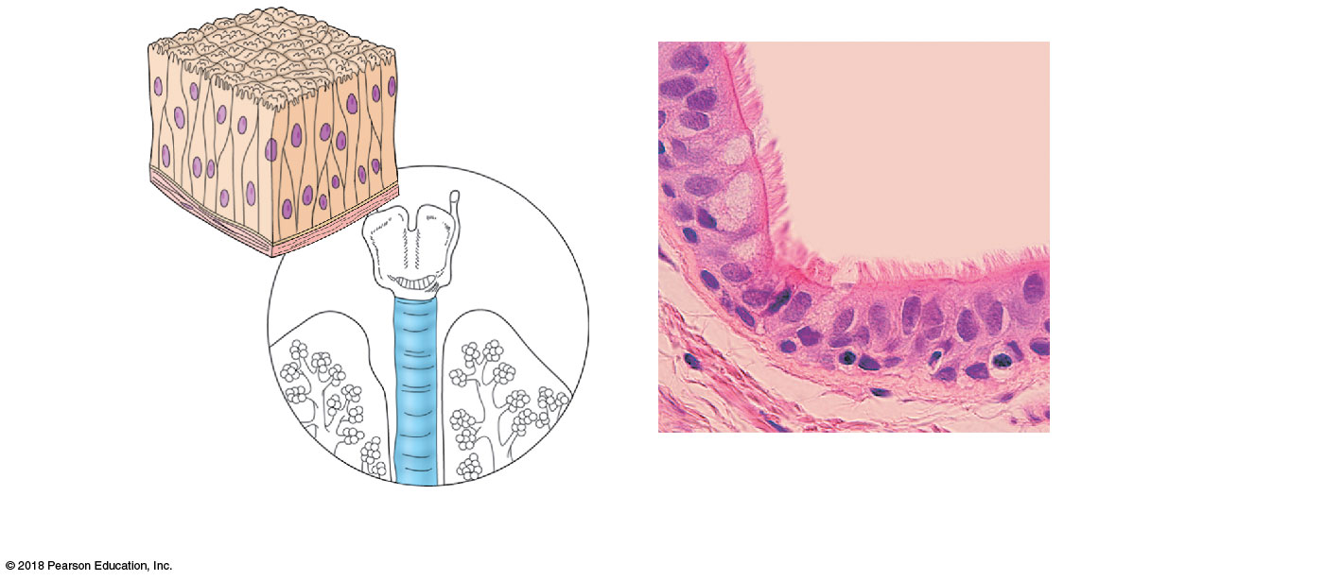
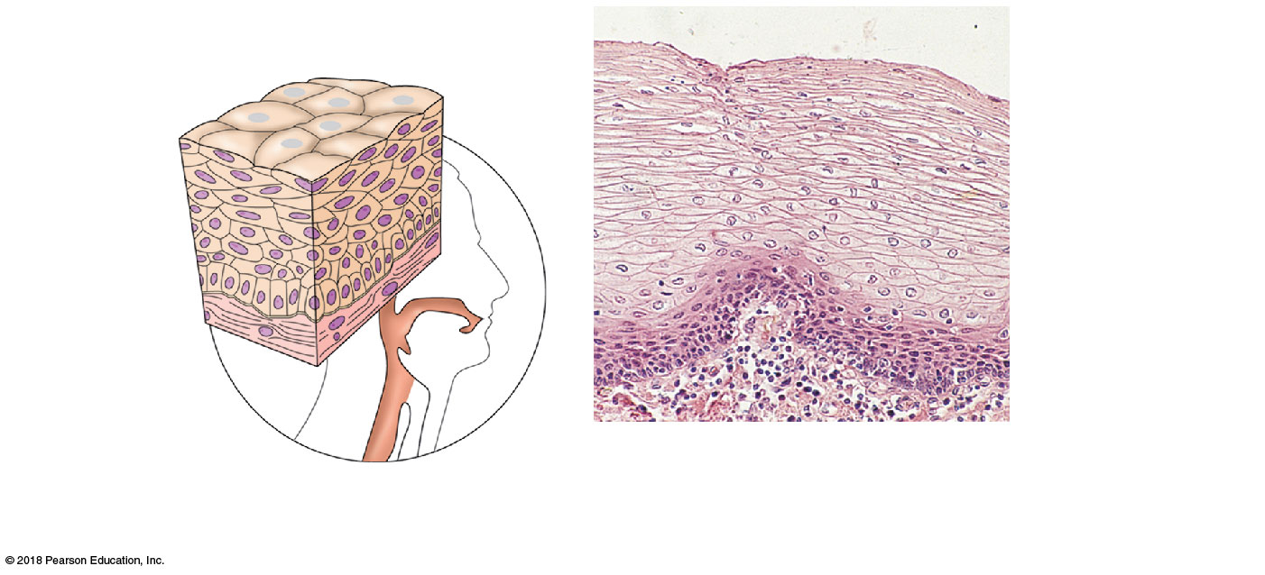
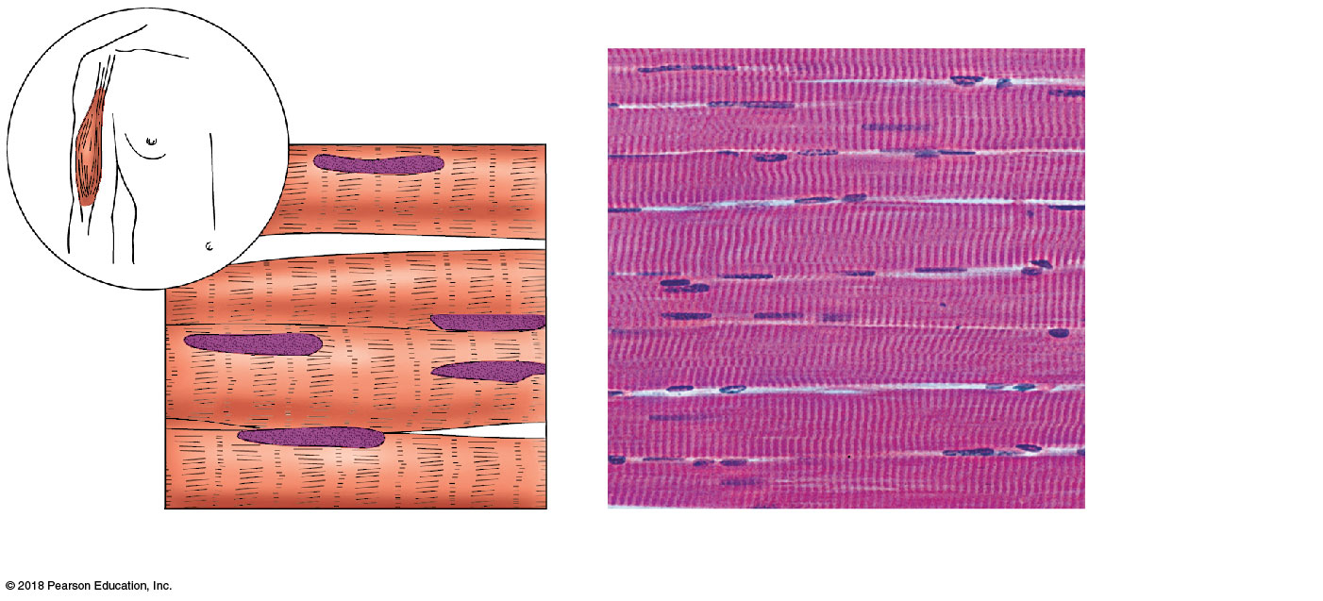
THE CELL
Each of these images shows cells from a different part of the body. Remembering that structure is related to function, which image shows cells from the skin?
Notes:
Each of these images shows cells from a different part of the body. Remembering that structure is related to function, which image shows cells from the skin?
Wait for answers, then (*CLICK*)
Why?

Slide 5
THE CELL
Each of these images shows cells from a different part of the body. Remembering that structure is related to function, which image shows cells from the respiratory tract?
Notes:
Each of these images shows cells from a different part of the body. Remembering that structure is related to function, which image shows cells from the respiratory tract?
Wait for answers, then (*CLICK*)
Why?

Slide 6
THE CELL
Each of these images shows cells from a different part of the body. Remembering that structure is related to function, which image shows cells from skeletal muscle?
Notes:
Each of these images shows cells from a different part of the body. Remembering that structure is related to function, which image shows cells from skeletal muscle?
Wait for answers, then (*CLICK*)
Why?

Slide 7
INTERCELLULAR JUNCTIONS
Most cells are bound to each other by plasma membrane connections called intercellular junctions
3 Types of Intercellular Junctions:
Tight junctions
Desmosomes
Gap junctions

Slide 8
INTERCELLULAR JUNCTIONS
Tight Junctions
Completely fuse cells together
Prevent substances from passing between cells
Forces substances to travel through cells

Slide 9
INTERCELLULAR JUNCTIONS
Desmosomes
Do not complete fuse cells together
Provide more strength than any other connection

Slide 10
INTERCELLULAR JUNCTIONS
Gap Junctions
Provide a passageway between cells
Allow molecules to flow freely between cells
Coordinates cellular activities

Slide 11
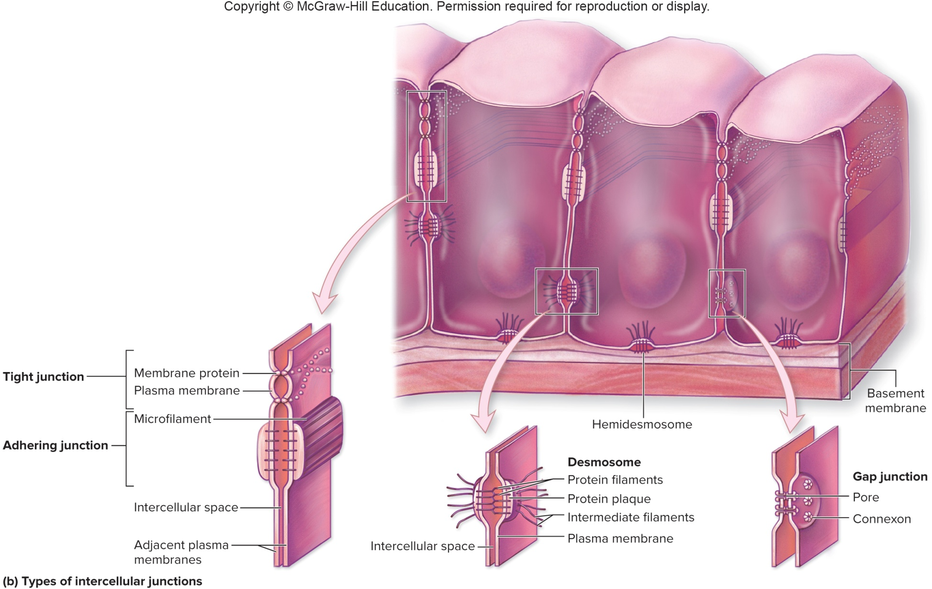
INTERCELLULAR JUNCTIONS

Slide 12
CELL CHANGES
Hypertrophy: An increase in the size of cells in an area
Hyperplasia: An increase in number of cells in an area
Atrophy: Shrinkage of tissue by cell size or number
Neoplasia: Out-of-control growth, which forms a tumor
Pre-neoplastic changes are referred to as dysplasia
Metaplasia: Cells change from one type to another

Slide 13
CELL CHANGES
Which image accurately shows HYPERPLASIA?
Notes:
13
13

Slide 14
CELL CHANGES
Which image accurately shows HYPERTROPHY?
Notes:
14
14

Slide 15
CELL CHANGES
Which image accurately shows METAPLASIA?
Notes:
15
15

Slide 16
CELL CHANGES
Which image accurately shows NEOPLASIA (or DYSPLASIA)?
Notes:
16
16

Slide 17
CELL CHANGES
Which image accurately shows ATROPHY?
Notes:
17
17

Slide 18
CELL DEATH
2 Mechanisms of Cellular Death
Necrosis
Death after severe damage
Intracellular contents spill out of cell
Triggers immune system and inflammatory response
Apoptosis
Cellular suicide, or programmed cell death
Intracellular contents are destroyed by lysosomes and do not spill out of cell
Protects the body from dying, virus-infected, or cancerous cells without triggering the immune system

Slide 19
THE CELL
Plasma Membrane
Nucleus
Cytoplasm

Slide 20
THE CELL
Cytoplasm = Cytosol + Organelles

Slide 21
CYTOPLASM: CYTOSOL
Cytosol: Jelly-like substance that fills the interior of a cell
AKA intracellular fluid
Contains dissolved nutrients for the cell to use

Slide 22
CYTOPLASM: ORGANELLES
Organelle: “Little organ”
Each organelle has a specific function
Allows the cell to be very efficient

Slide 23
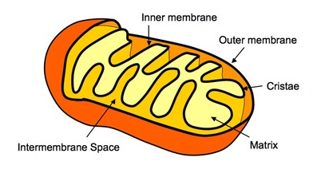
ORGANELLES: MITOCHONDRIA
Function = Production of energy (ATP)
“Powerhouse” of the cell
Folding membranes make mitochondria more efficient

Slide 24
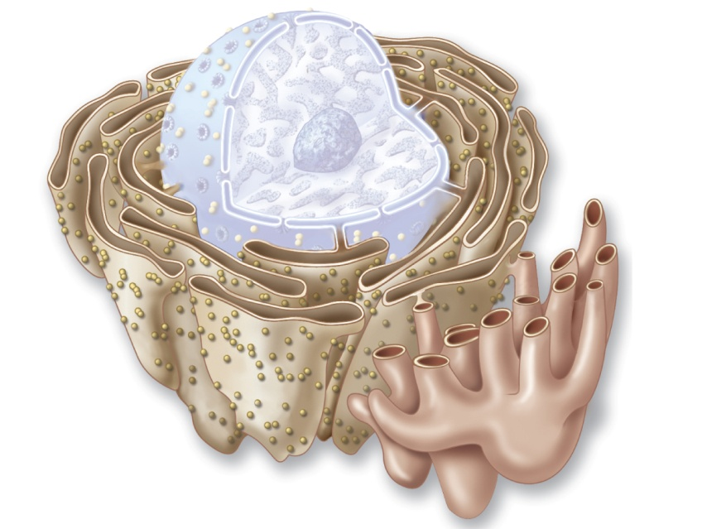
ORGANELLES: ENDOPLASMIC RETICULUM
Function = Synthesis and transport
The ER is like the blood
2 Types
Rough ER
Smooth ER
RER has ribosomes
Nucleus
Ribosomes
Rough ER
Smooth ER

Slide 25
ORGANELLES: ENDOPLASMIC RETICULUM
Rough ER
Surrounded by ribosomes
Makes proteins that:
Leave the cell
Go into the plasma membrane
Go into lysosomes
Smooth ER
Makes and transports fat, carbohydrates, calcium, and waste
Calcium = rigor mortis
Transport of waste = Detoxification
The cells of what organ have well developed SMOOTH ER?

Slide 26
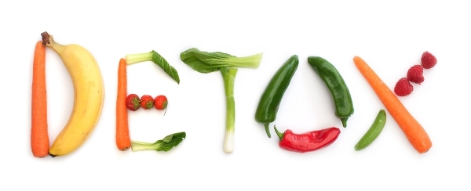
ORGANELLES: ENDOPLASMIC RETICULUM

Slide 27
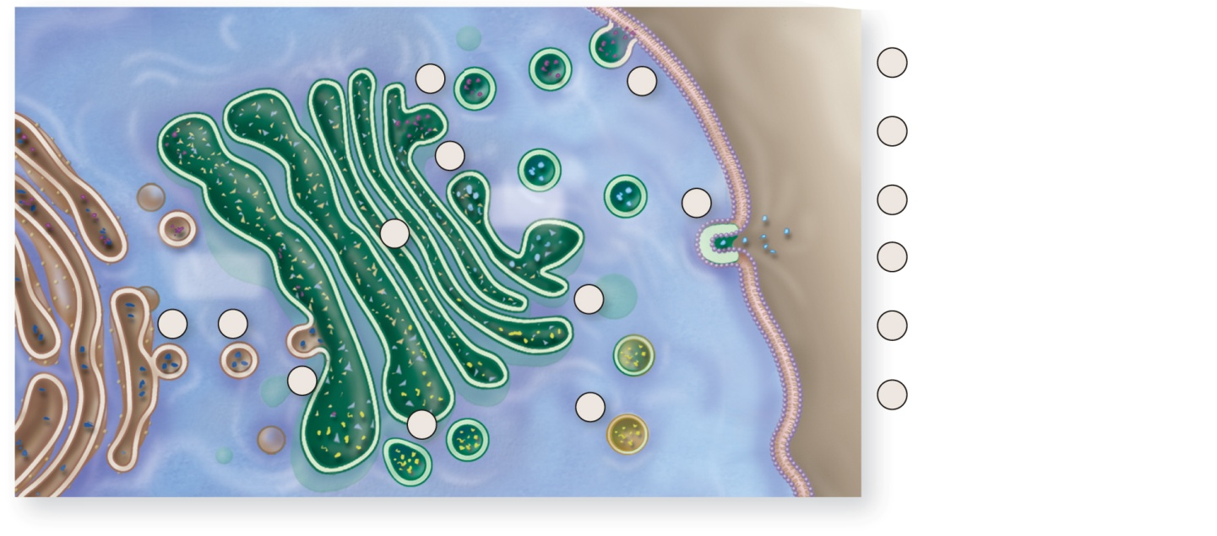
ORGANELLES: GOLGI APPARATUS
Function = Modification and transport of proteins out of the cell
“Rough Endoplasmic Reticulum part II”
Material is exported in vesicles
Rough
endoplasmic
reticulum
(RER)
Synthesis, Modification, and Shipping of Proteins
Golgi
apparatus
1
RER synthesizes protein that is released in a transport vesicle.
5
6a
Extracellular
fluid
2
Vesicle from the RER moves to the Golgi
apparatus.
5
Plasma
membrane
Shipping
region
6b
3
Vesicle fuses with Golgi apparatus at the
receiving region.
4
Receiving
region
4
Proteins are modified as they move through
Golgi apparatus (e.g., addition of carbohydrate).
5
Exocytosis
1
2
5
Modified proteins are packaged and released
within secretory vesicle from the shipping region.
3
Lysosomes
6
Secretory vesicles (6a) merge with the plasma
membrane to insert molecules into the plasma
membrane (6b), or release contents by exocytosis.
(6c). They may also serve as lysosomes.
4
6c
Transport
vesicles

Slide 28
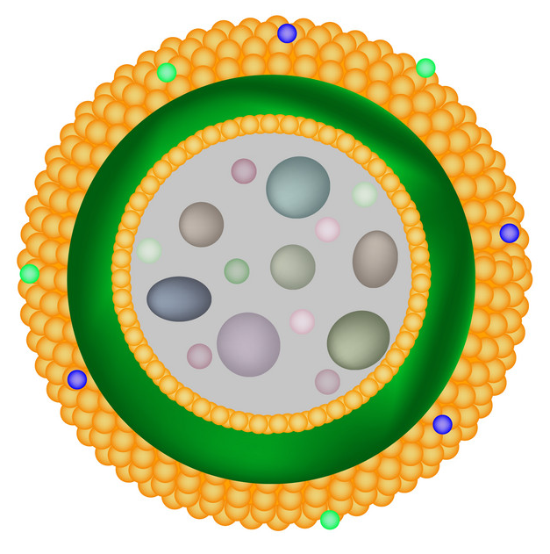
ORGANELLES: LYSOSOMES
Function = Digestion
Lysosomes are like the digestive system
Sacs or vesicles
Enzymes from the RER break down food, bacteria, and worn-out organelles

Slide 29

ORGANELLES: PEROXISOMES
Function = Protection
Peroxisomes are like the lymphatic (immune) system
Sacs or vesicles
Enzymes from the RER break down hydrogen peroxide
Prevents formation of harmful oxygen free-radicals

Slide 30
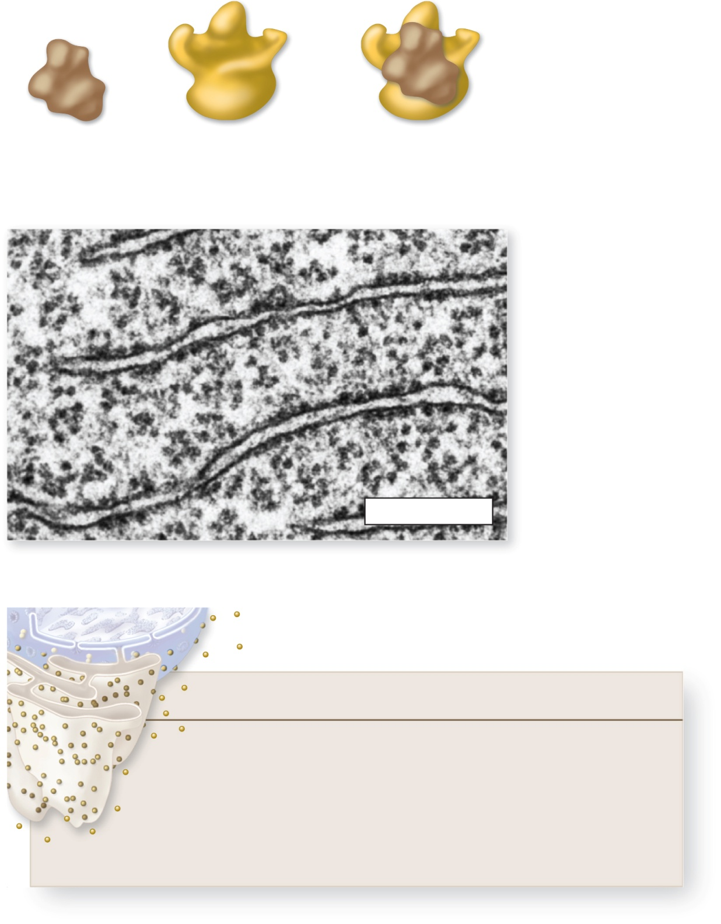
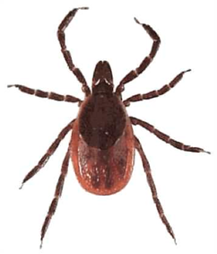
ORGANELLES: RIBOSOMES
Function = Make protein
Receive information from DNA to create proteins
Ribosomes in the cytoplasm = Proteins for the cell
Ribosomes in the RER = Proteins for outside the cell
+
=
Small subunit
Large subunit
Functional ribosome

Slide 31
ORGANELLES: CYTOSKELETON
Function = Structure and Movement
The Cytoskeleton is like the musculoskeletal system
Fibers
Small = Microfilaments
Medium = Intermediate fibers
Large = Microtubules
Variations:
Mitotic Spindle
Flagella
Cilia
Microvilli

Slide 32
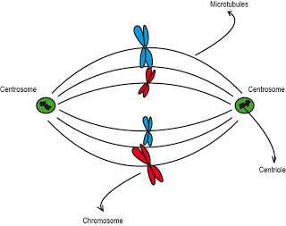
MITOTIC SPINDLE
Function = Cell division
Structure = Microtubules + Centrosomes
Centrosomes = 2 Cylinders perpendicular to each other
Each cylinder is called a centriole
Microtubules + Centrosomes together form the mitotic spindle during cell division
The spindle moves the chromosomes (DNA) so that each new cell gets the right amount of genetic material

Slide 33
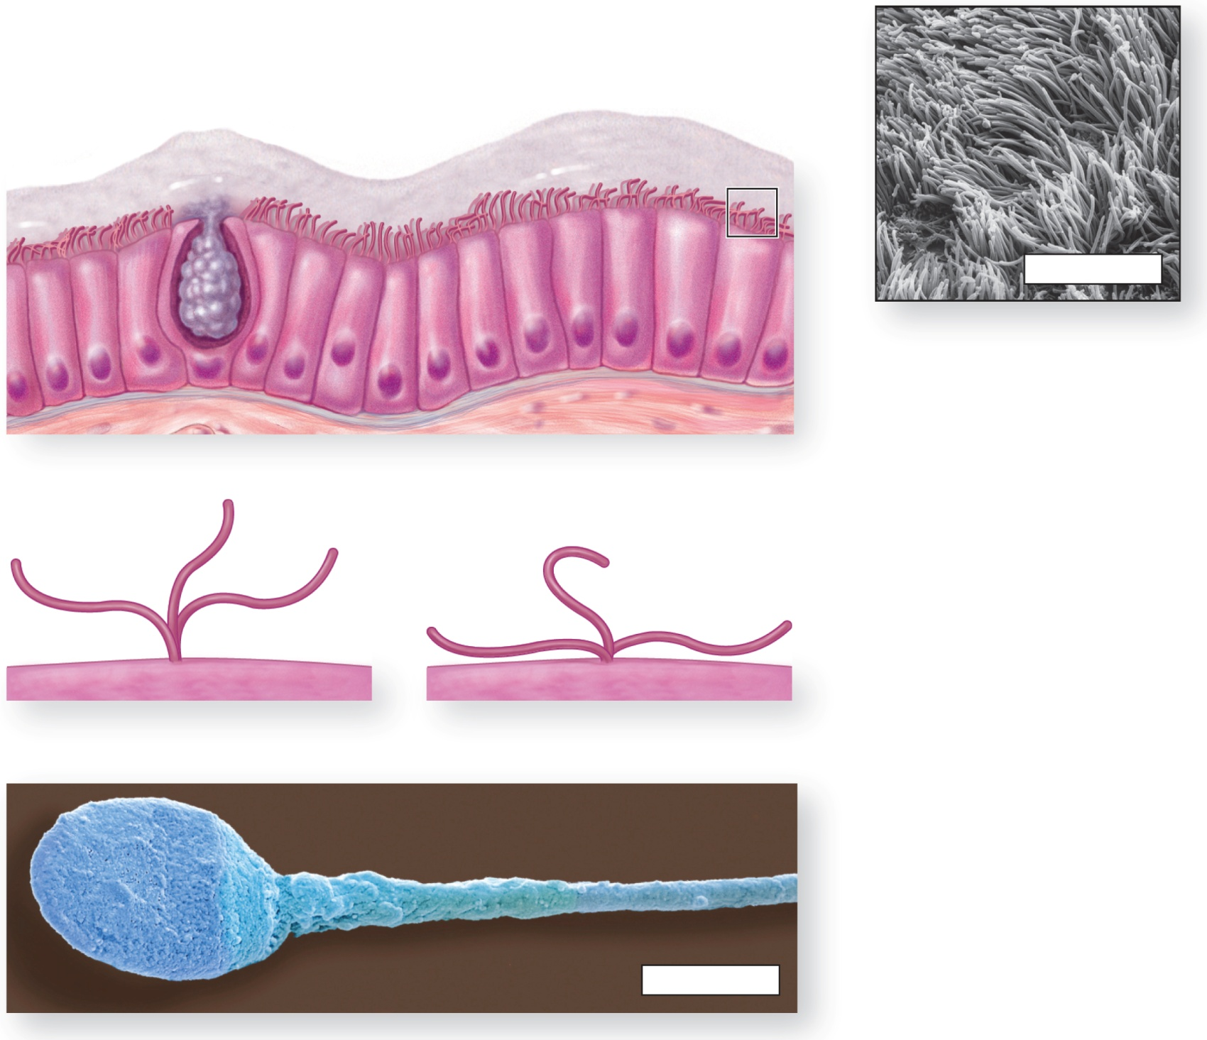
ORGANELLES: CYTOSKELETON
Goblet cell (secretes mucus)
Cilia
Layer of mucus
SEM 6000x
Flagellum
FLAGELLA = Directional movement
Power Stroke
Return Stroke
CILIA = Beating movement
MICROVILLI = Increase surface area

Slide 34

CASE STUDY
Enrique has Situs Inversus
Enrique is frequently sick
Runny nose
Cough
Ear infections
This time, Enrique is diagnosed with pneumonia
He does NOT have the plasma membrane disease, Cystic Fibrosis

Slide 35
CASE STUDY
Doctors now suspect Enrique may have Primary Ciliary Dyskinesia
PCD = Cells make non-functional cilia
Discuss with your Neighbor: How could cilia problems cause runny nose, cough, and pneumonia?

Slide 36
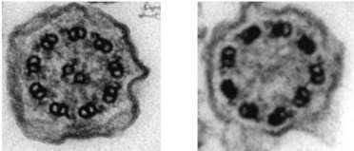
CASE STUDY
The image on the left shows normal cilia on a sinus cell, the image on the right shows the cilia on Enrique’s upper respiratory cells
Normal cilia
Enrique’s cilia
What is different about Enrique’s cilia?

Slide 37
CASE STUDY
Enrique can live with PCD, but will continue to suffer from frequent respiratory infections
What about Situs Inversus?
Cilia play a role in organ placement during embryonic development
If cilia are non-functional, organ placement becomes random
People with Primary Ciliary Dyskinesia have a 50% chance of having Situs Inversus

Slide 38
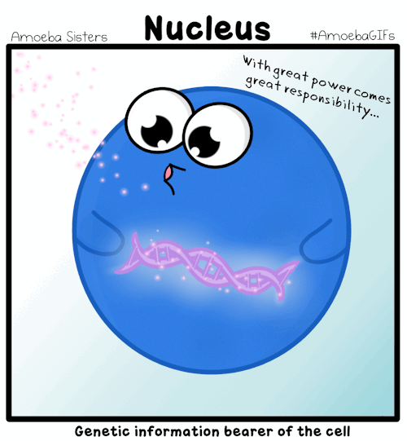
ORGANELLES: NUCLEUS
Function = Control protein synthesis
Controlling proteins means controlling the cell
The nucleus is like the brain
Controls protein creation via genes – DNA
DNA organized into units called chromosomes

Slide 39
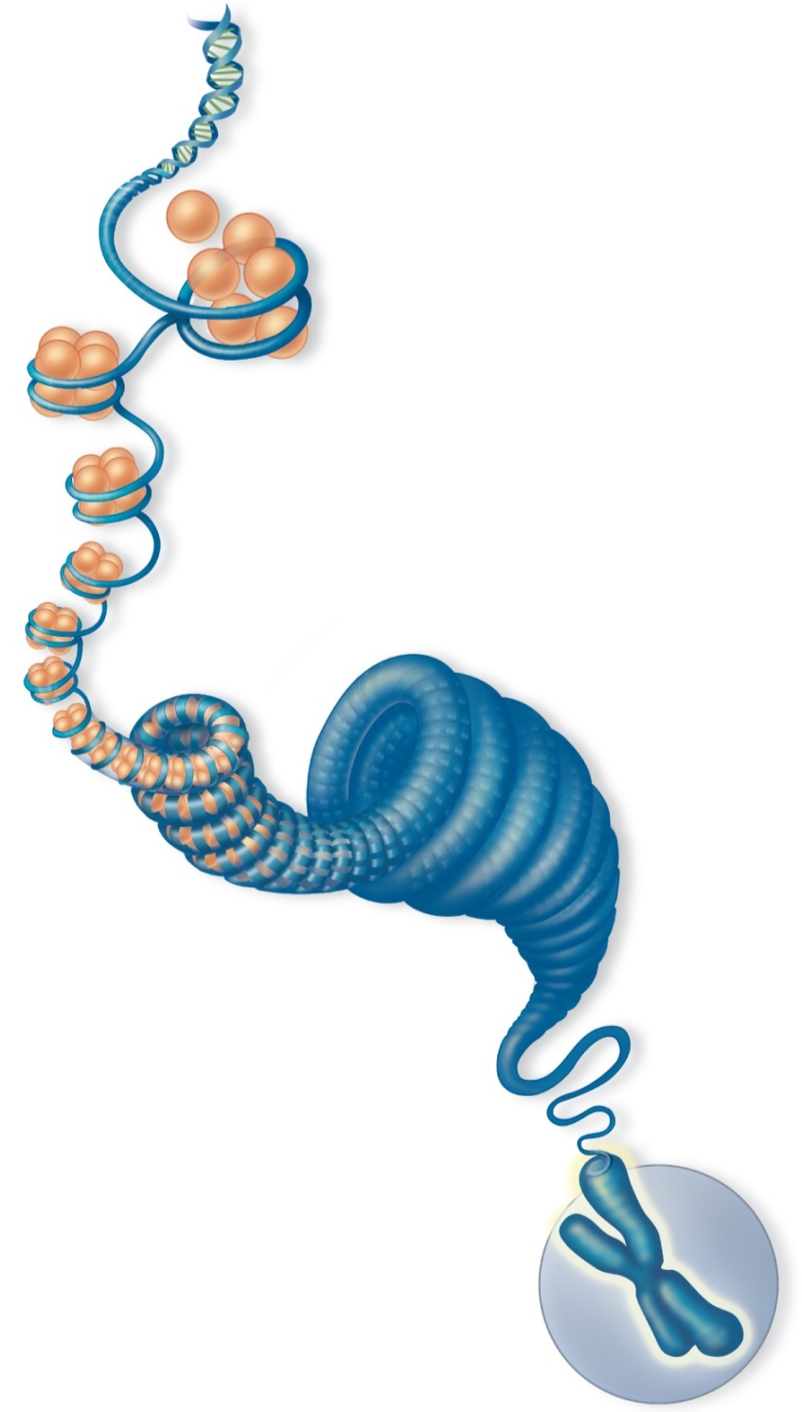
ORGANELLES: NUCLEUS
Chromosomes = Genetic information within the nucleus
Contains DNA
Chromatin = DNA + histones that give chromosomes their shape
Histones
DNA
Coiled chromatin
Chromosome

Slide 40
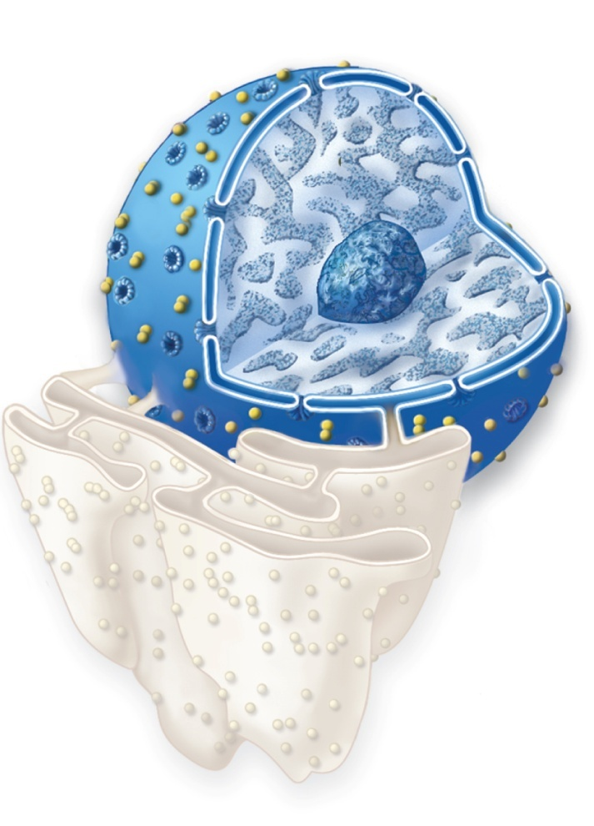
ORGANELLES: NUCLEUS
Chromosomes = Genetic information within the nucleus
Contains DNA
Chromatin = DNA + histones that give chromosomes their shape
Nucleolus = Makes ribosomes
Nuclear Envelope = Specialized plasma membrane with pores that allow mRNA to exit
Nucleus
Nuclear
pores
Nuclear
envelope
Nucleolus
Chromatin
Rough endoplasmic
reticulum

Slide 41

ORGANELLES: NUCLEUS
How DNA makes Protein
DNA in the nucleus holds genetic information in genes
mRNA is a copy of nuclear DNA that can leave the nucleus
mRNA finds a ribosome in the cytoplasm or RER
Ribosome reads mRNA to produce a protein
Transcription
Translation
DNA
RNA
Protein
What are examples of proteins in the cell?
Notes:
41
41

Slide 42
ORGANELLES: NUCLEUS
Hair color and texture
Eye color
Histone proteins
All enzymes in your lysosomes and peroxisomes
All enzymes digestive tract – Lactose Intolerant?
Insulin receptors – Type II Diabetes?
CFTR channels – Cystic Fibrosis?
Cholesterol (LDL) receptors – high cholesterol?
Hemoglobin production – Sickle Cell Anemia?
Notes:
42
42

Slide 43
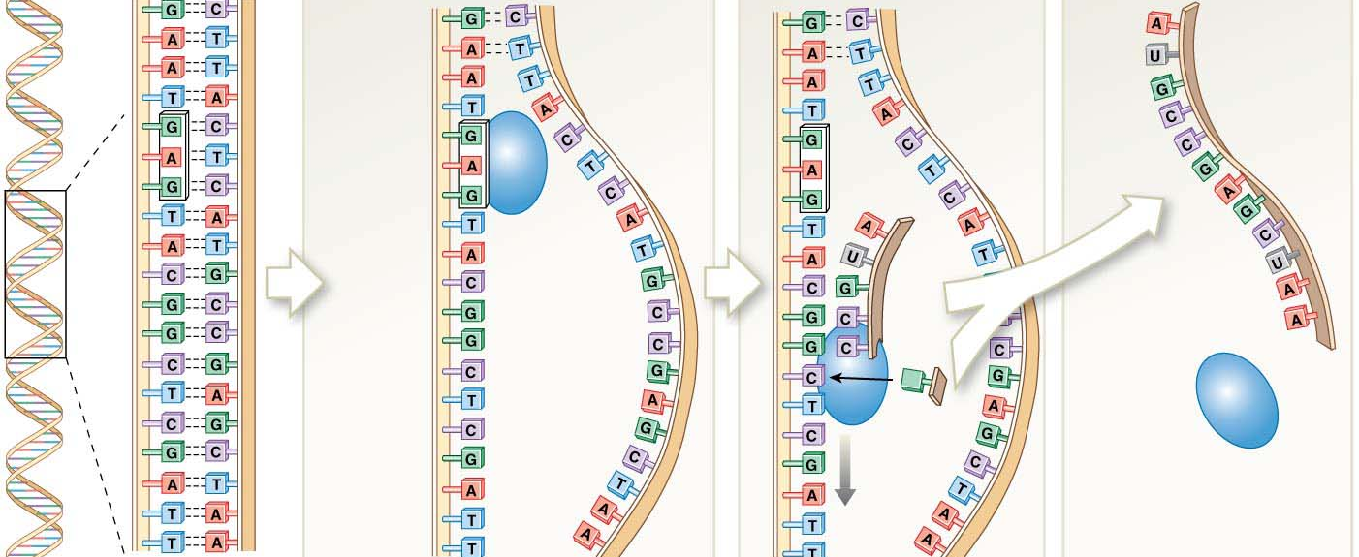
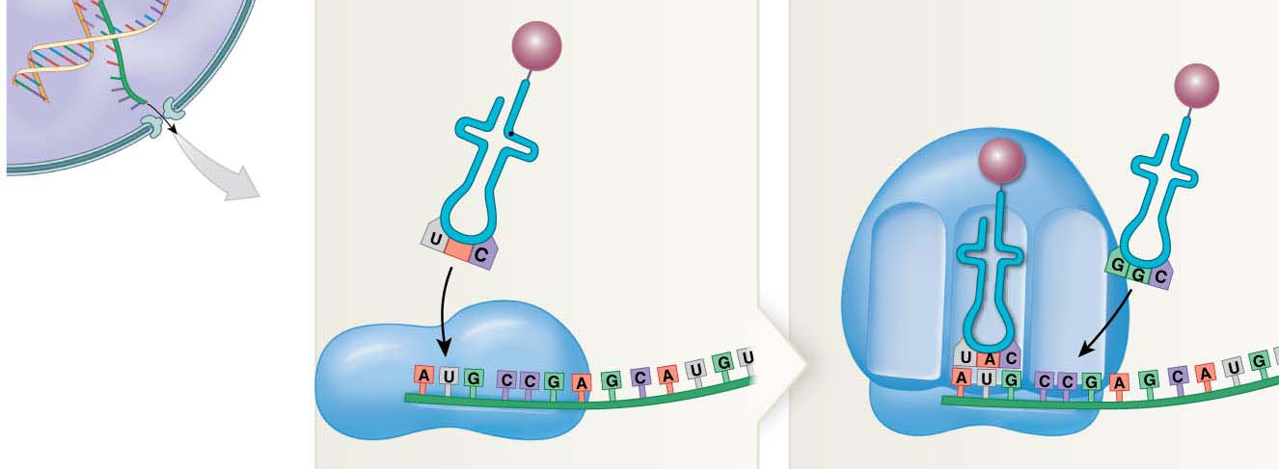
ORGANELLES: NUCLEUS
Transcription
Translation

Slide 44
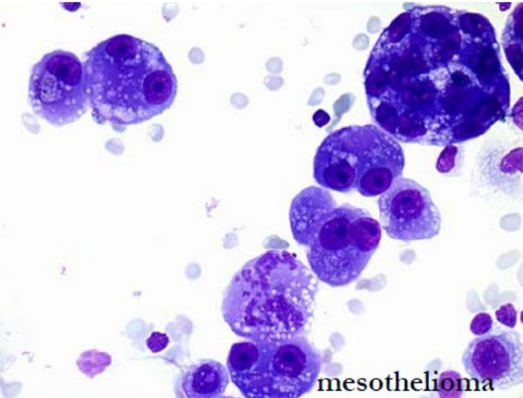
ORGANELLES: NUCLEUS

Slide 45
ORGANELLES: NUCLEUS
Genetic diseases, like Cystic Fibrosis or Sickle Cell Anemia, occur because the body is making abnormal proteins
Which component of the Central Dogma is the source of a genetic disease?
Transcription
Translation
DNA
RNA
Protein
Notes:
45
45

Slide 46
ORGANELLES: NUCLEUS
Which image accurately shows protein production?
Translation
Transcription
DNA
RNA
Protein
Transcription
Translation
RNA
DNA
Protein
Transcription
Translation
DNA
RNA
Protein
Transcription
Translation
DNA
Protein
RNA
Notes:
46
46

Slide 47

THE CELL CYCLE
The Cell Cycle = The life of a cell
Includes cellular activity, growth, and reproduction
Consists of 2 BIG stages:
Interphase
Mitosis

Slide 48
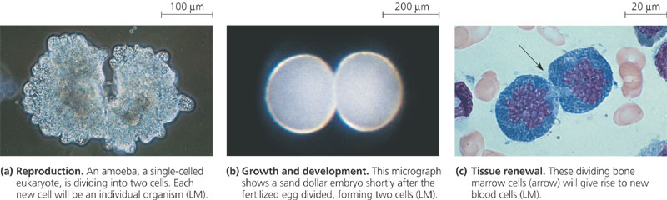
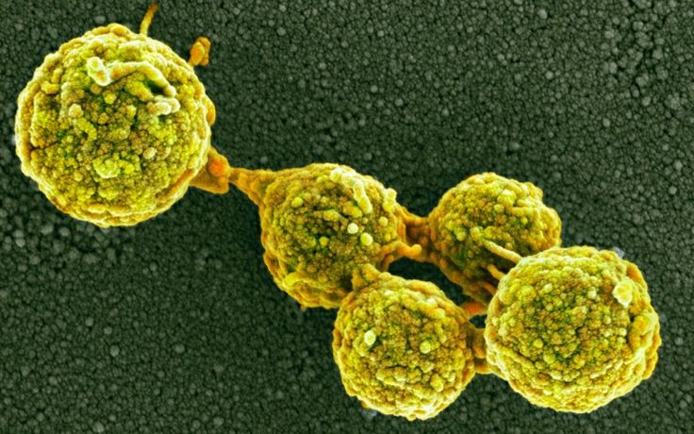
THE CELL CYCLE
ALL cells divide

Slide 49
THE CELL CYCLE
Chromosomes = Linear sequences of genes made of DNA and histones
Histones are proteins that tightly coil DNA so it fits in a nucleus
Every species has a characteristic number of chromosomes in every cell nucleus – 2 non-identical copies of each called Homologous Chromosomes
Humans = 46
Dogs = 78

Slide 50
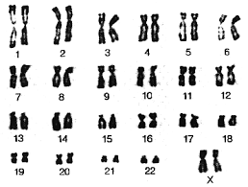
CHROMOSOMES
Homologous Pair

Slide 51
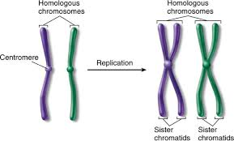
Homologous Pairs vs. Sisters
CHROMOSOMES

Slide 52
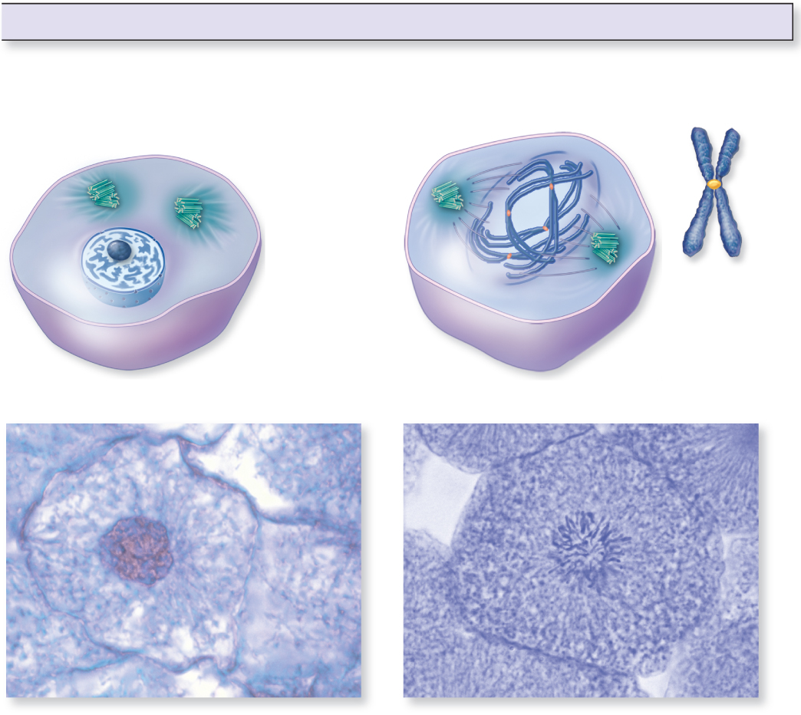
THE CELL CYCLE: INTERPHASE
Stage of cell cycle during which DNA synthesis occurs and the nucleus is not actively dividing
Cells are carrying out their normal cellular activities
3 steps of Interphase:
G₁
S – DNA replicates, sister chromatids formed
G₂
Centrosomes
Chromatin
Nucleolus
Nuclear envelope
Plasma membrane
Nucleus with chromatin

Slide 53
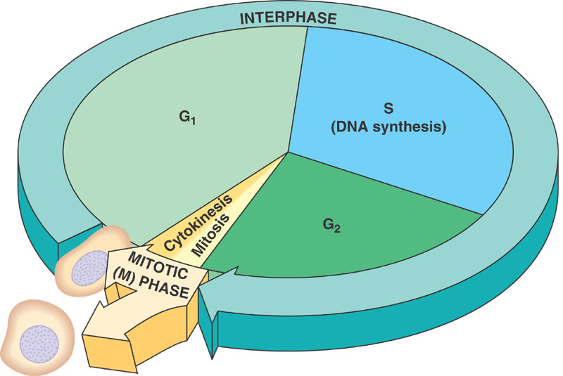
THE CELL CYCLE

Slide 54
THE CELL CYCLE: MITOSIS
The multistep process that results in cell division with the separation of the sister chromatids
Occurs during growth, healing, and maintenance
4 Steps of Mitosis:
Prophase
Metaphase
Anaphase
Telophase

Slide 55
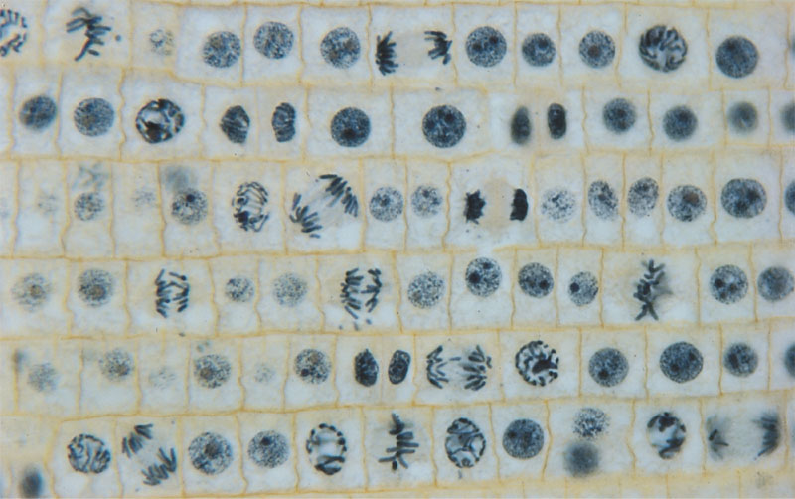
THE CELL CYCLE: Mitosis

Slide 56
MITOSIS: PROPHASE
1st phase of Mitosis
Chromosomes condense
Nuclear membrane disappears
Chromosomes are now accessible
Mitotic spindle begins to form

Slide 57
MITOSIS: Prophase
Sister
chromatids
Centrosomes
Identical sister chromatids
Chromatin
Nucleolus
Nuclear envelope
Plasma membrane
Developing
spindle
Nucleus with chromatin
Nucleus with
dispersed replicated chromosomes
G₂ of Interphase
Prophase
Notes:
57

Slide 58
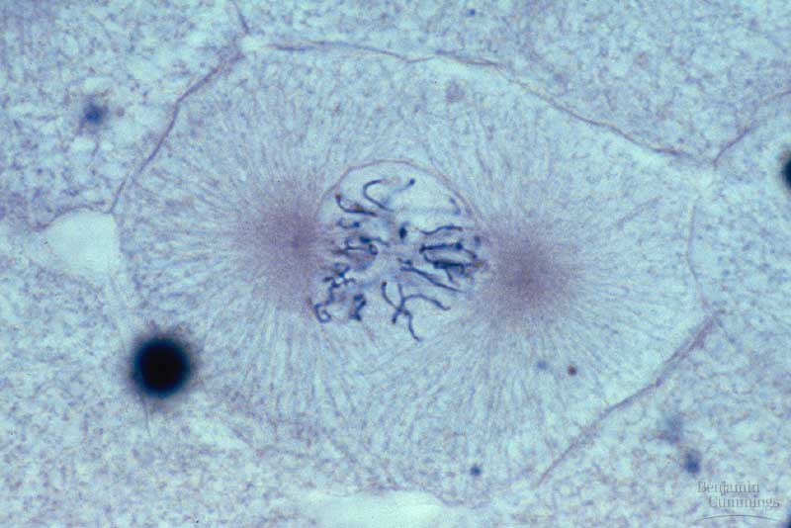
MITOSIS: Prophase

Slide 59
MITOSIS: PROPHASE
Mitotic Spindle = The structure that pulls the sister chromatids apart
Spindle microtubules attach to each side of the chromosome

Slide 60
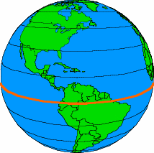
MITOSIS: METAPHASE
2nd phase of Mitosis
The mitotic spindle lines chromosomes up along the metaphase plate
Metaphase plate is like the “equator” of the cell

Slide 61
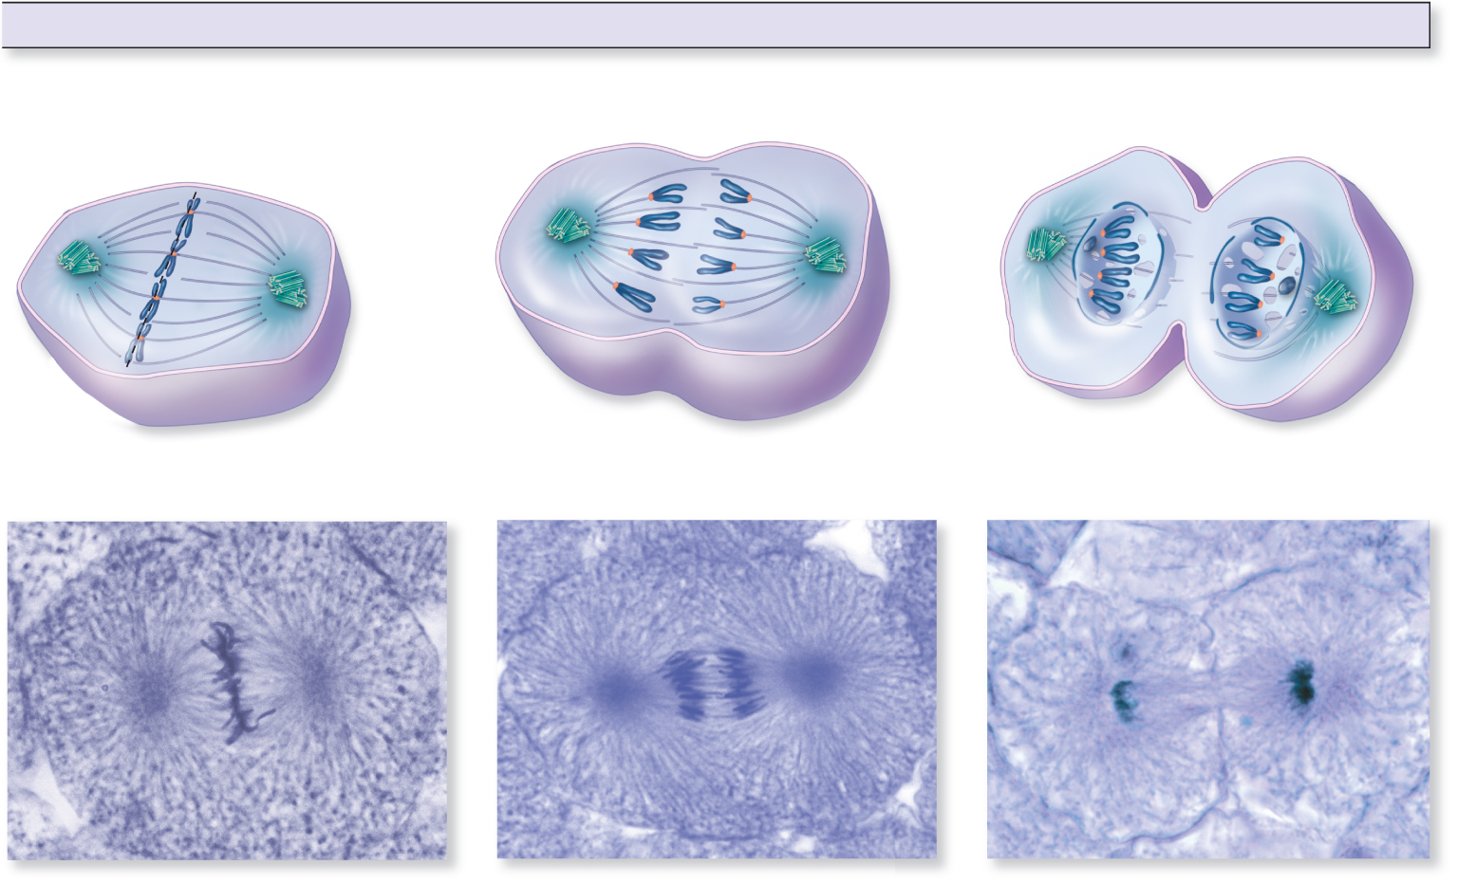
MITOSIS: METAPHASE
Metaphase plate
Spindle fibers
Centrosome
Sister chromatids
aligned on metaphase plate
Spindle fibers

Slide 62
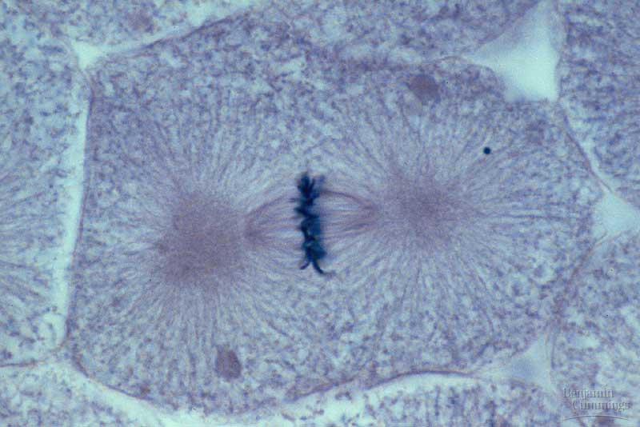
MITOSIS: Metaphase

Slide 63

MITOSIS: ANAPHASE
Sister chromatids are pulled apart
This is the actual DIVISON!
Newly separated sister chromatids migrate to opposite sides of the cell

Slide 64
MITOSIS: ANAPHASE
Sister chromatids being pulled apart
Sister chromatids being pulled apart
Spindle fibers
Notes:
64

Slide 65
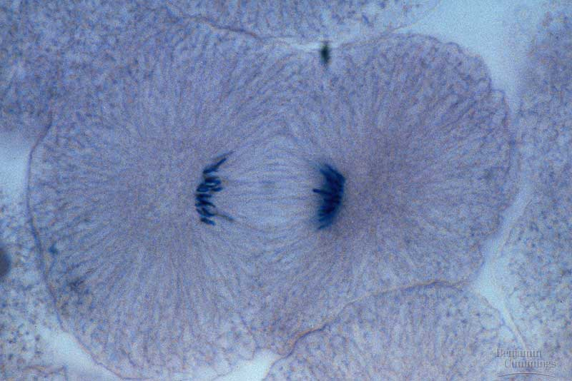
MITOSIS: Anaphase

Slide 66
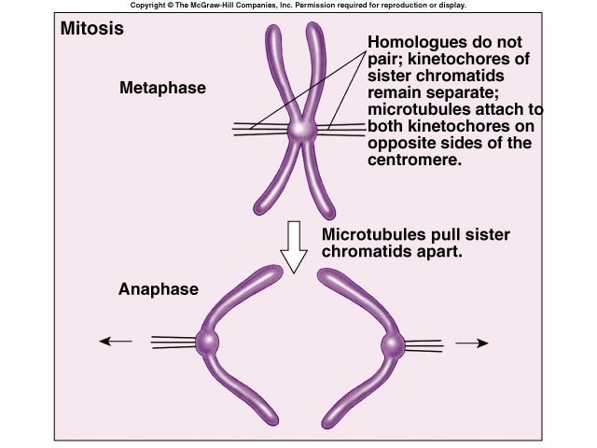
MITOSIS: ANAPHASE

Slide 67
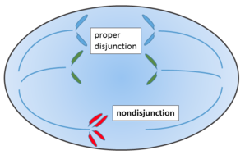
MITOSIS: ANAPHASE

Slide 68
MITOSIS: TELOPHASE
Daughter nuclei form
Spindle disappears
Nuclear membrane reforms over the chromosomes
Cytokinesis occurs – division of everything within the cytoplasm

Slide 69
MITOSIS: TELOPHASE
Re-forming
nuclear
envelope
Cleavage furrow
of cytokinesis
Nucleolus
Single chromosome
Cytokinesis occurring
Cleavage furrow
Notes:
69

Slide 70
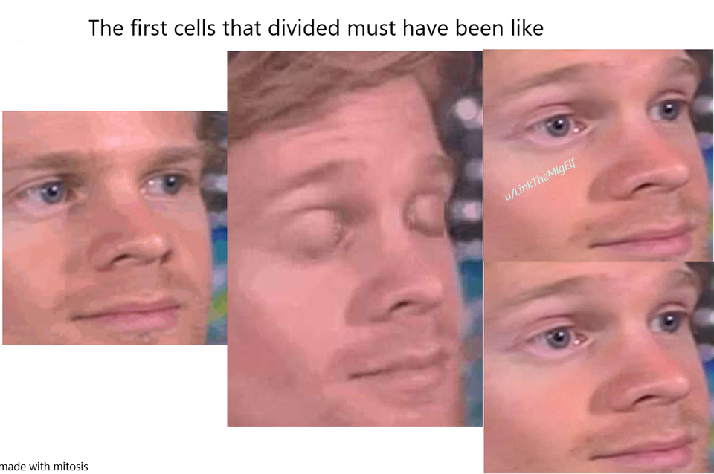
MITOSIS SUMMARY
One cell division
Two daughter cells produced
Daughter cells are genetically identical
Mitosis goes to great lengths to preserve genetic information!

Slide 71
Which image that accurately depicts Metaphase?

Slide 72
Which image accurately depicts Prophase:

